Slide 1


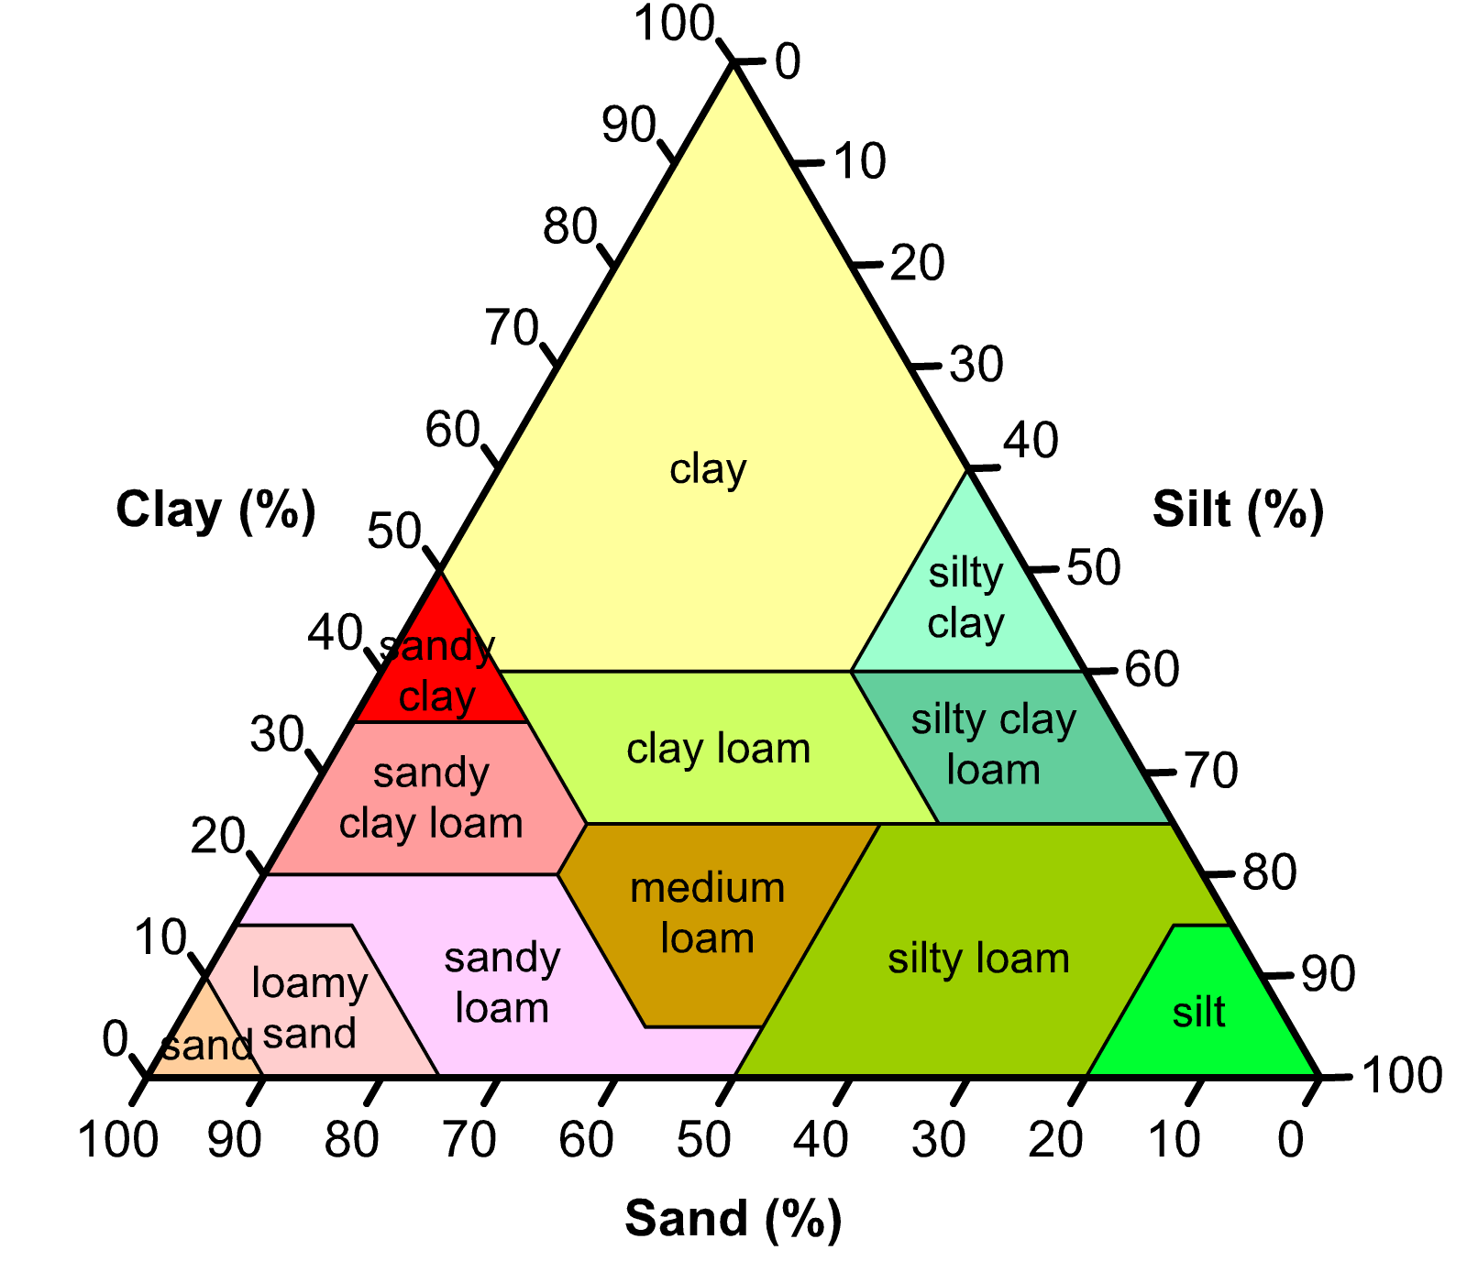
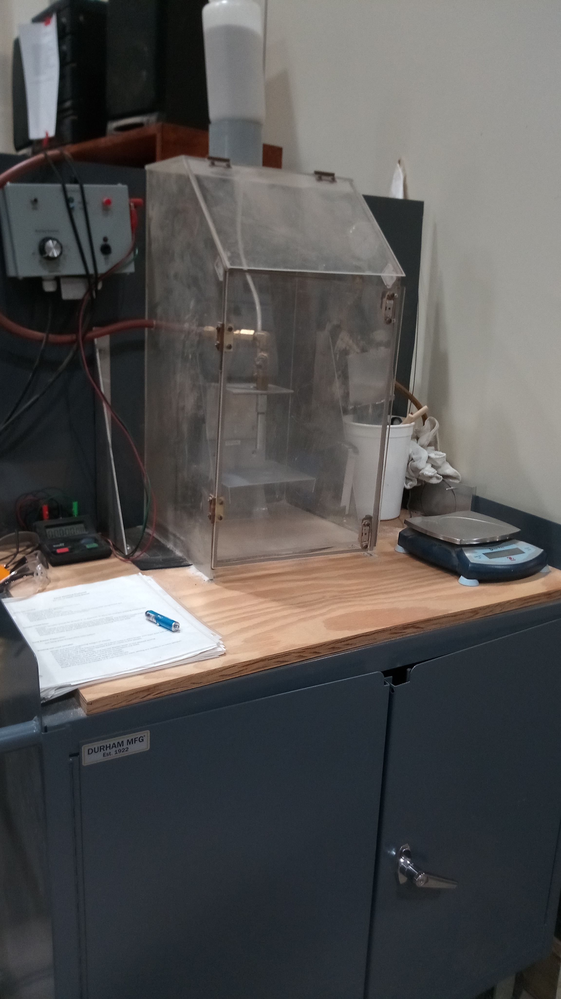
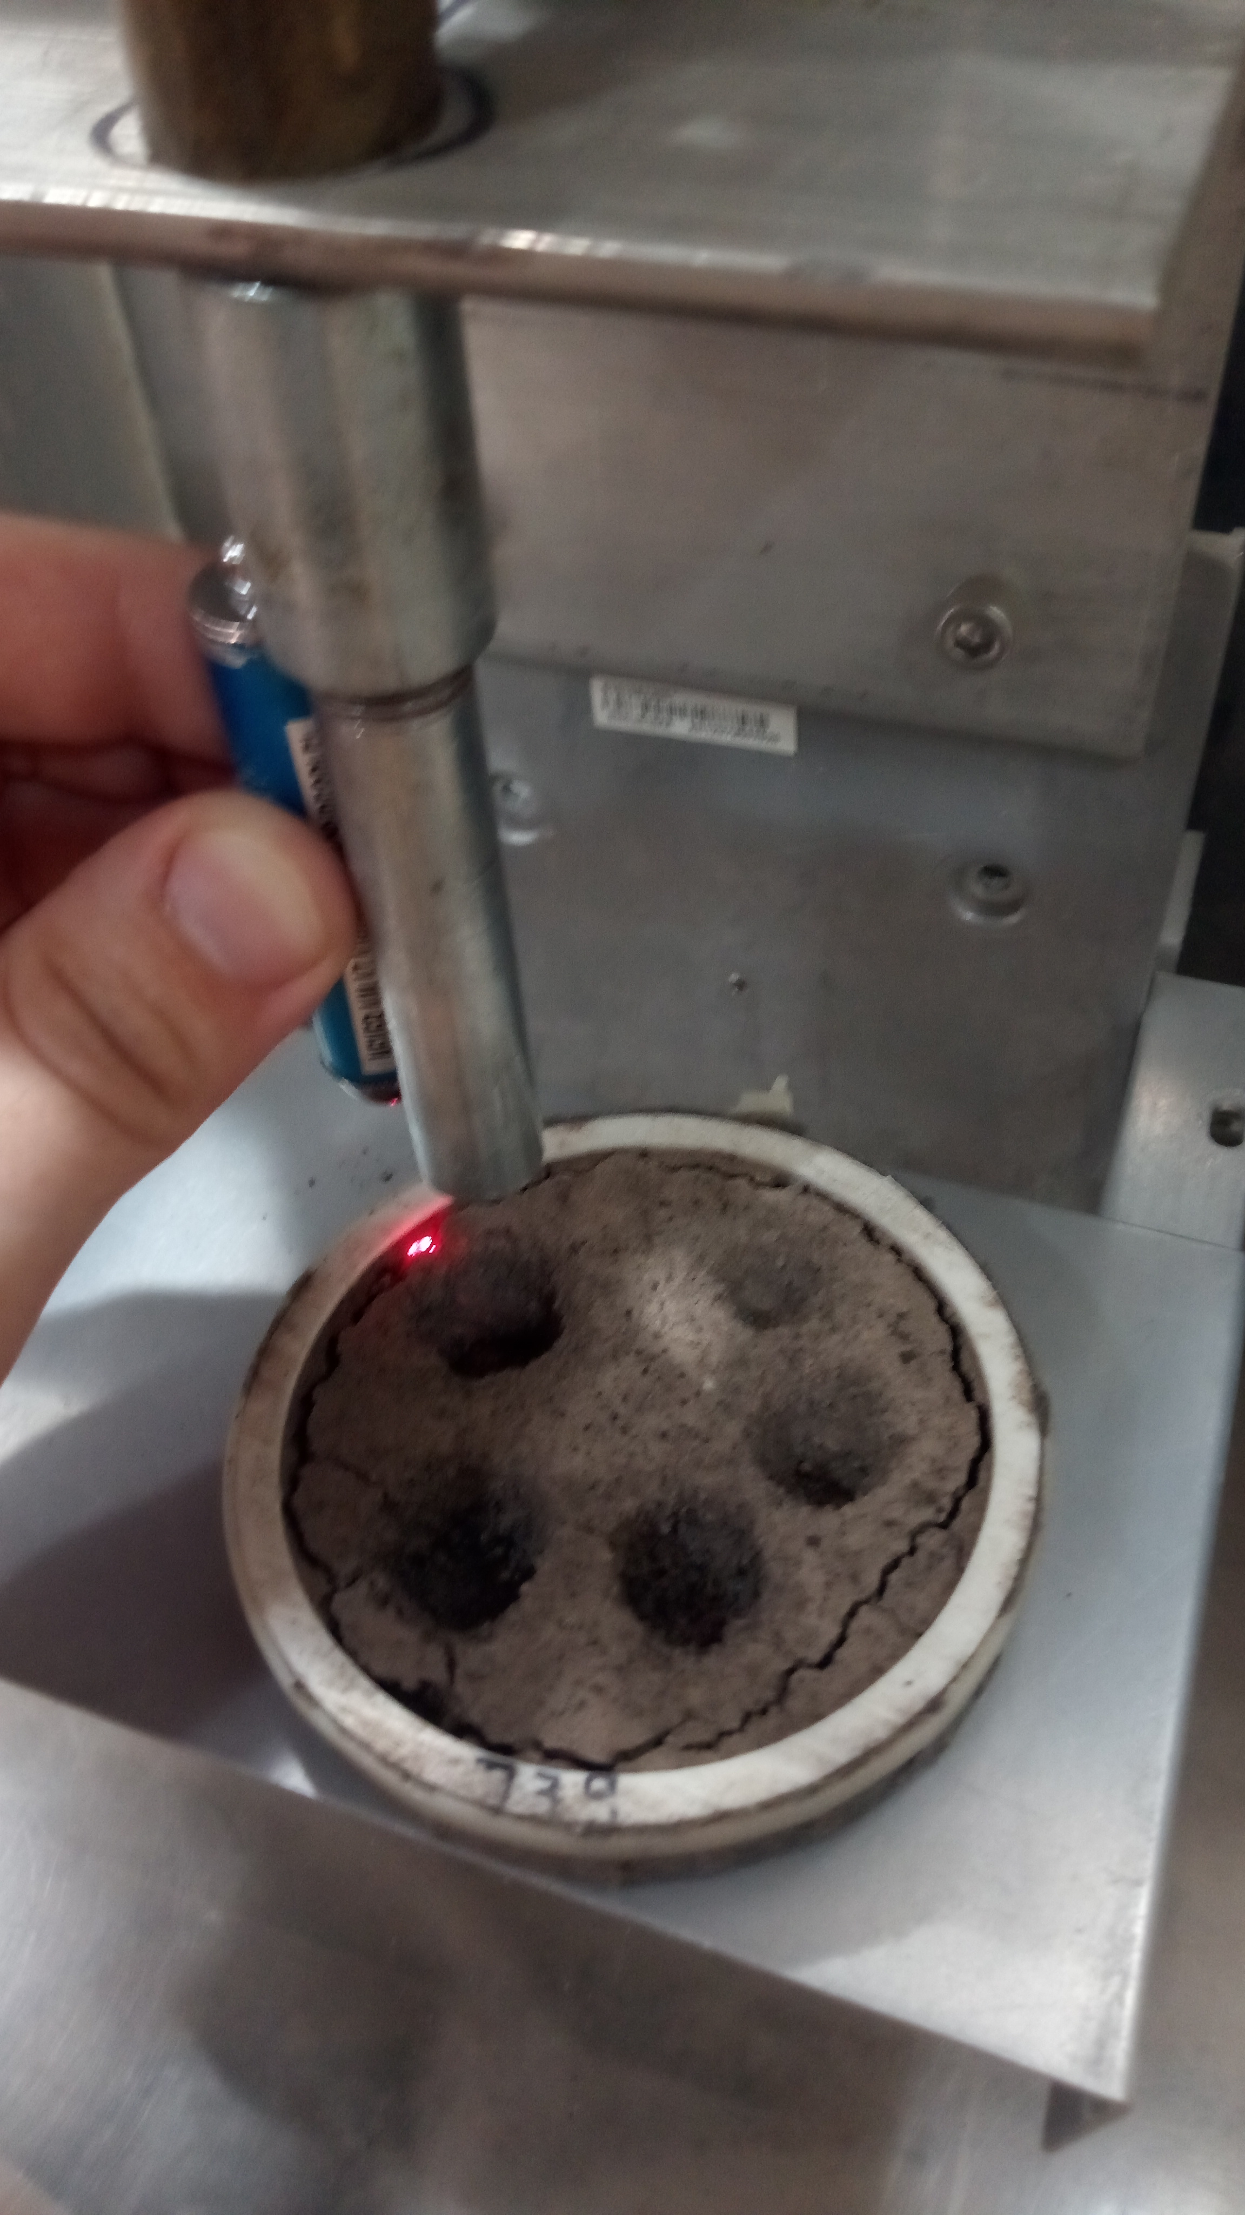
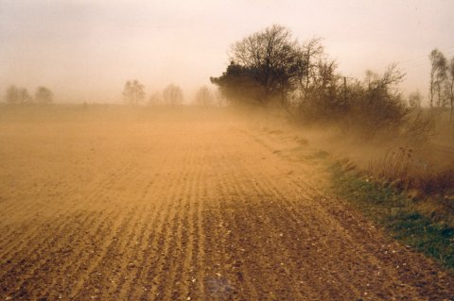
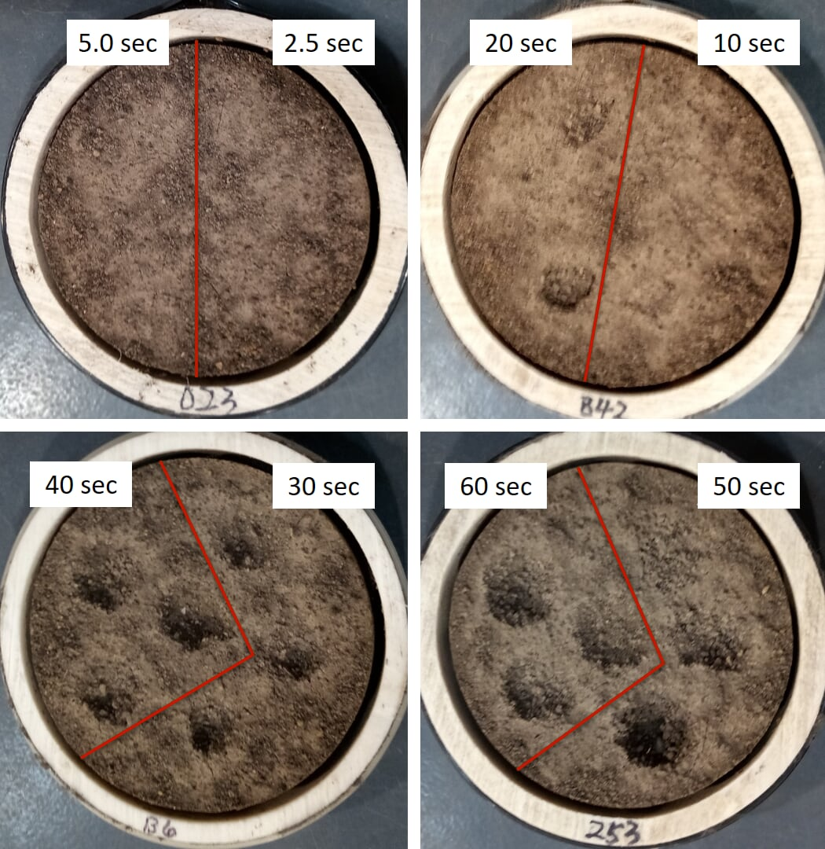
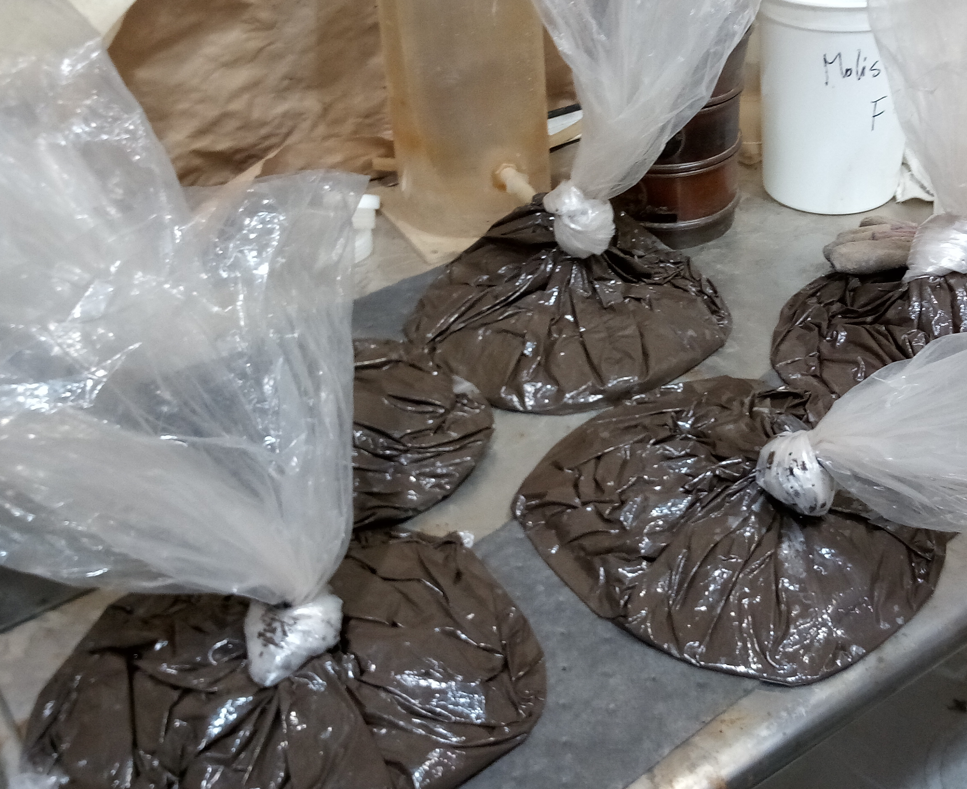
Effects of Freeze-Thaw Cycles and Moisture Content on Soil Crust Strength
Samir Youseftaha¹, Chi-Hua Huang², Laura Sanders¹, Jean Hemzacek¹, & Kenneth Voglesonger¹
¹Northeastern Illinois University, Chicago, IL ²USDA-Agricultural Research Service, National Soil Erosion Research Laboratory, West Lafayette, IN
Abstract
The repeated freeze-thaw cycle is known to cause the breakdown of soil aggregates. Experiments that study this effect generally subject soil samples to abrasion in wind tunnels, a laborious process. This study employed a simplified abrasion technique, by impinging sand particles using a sand blaster, and measuring the mass of detached soil. Strength variability was then quantified under a range of simulated over-winter conditions. In this study, two freeze-thaw experiments were conducted. The first used pre-formed crust samples that were periodically wet and dried, and the second used bulk soils that remained at constant saturation. A laboratory rainfall simulator was used to form a surface seal on 104 samples of Mollisol-type soils from northwestern Indiana. After a period of air-drying, abrasive sand blasting was conducted to simulate the process of wind erosion. Preliminary data suggest a number of general trends. The mass loss from pre-formed crusts was greater than that from bulk soils, indicating that periodic soil wetting and drying is the greatest contributor to crust friability. Greater time spent in processing cycles is also linked with increased mass loss. For pre-formed crusts, freeze-thaw increased soil removal rates at shorter abrading durations. For bulk soils, greater water content contributes to greater soil crust strength. This assessment helped to confirm assumptions about strength variability. It provided measured insights and methodologies for further inquiry into the studies of wind erosion and freeze-thaw cycles. These procedures should be used to examine different soils and explore the effects of amendments like gypsum and limestone.
Introduction
Results
Discussion
Soil erosion is a serious threat to global agriculture.
10 million ha of cropland are lost each year
Wind erosion tunnels are expensive and laborious
Objective: Examine soil crust strength against wind erosion, modeling freeze-thaw cycles and different moisture contents, using a sandblaster to model abrasion by wind.
Freeze-thaw cycles – reduce soil aggregate stability
Moisture content – increase soil cohesion
NSERL Sandblaster – simplifies wind erosion research
Silt-Loam Mollisol – high quality agricultural soil prevalent in the Midwestern US
Experiment 1:
Different rainfall simulators and nozzles were mistakenly used
Analysis of F-T effects difficult
No comparisons can be made between cycles
Experiment 1 samples had on average 200% more mass loss at 60 seconds of abrasion
Periodic wetting and drying are the greatest contributor to soil crust friability
Experiment 2:
Freeze-Thaw & Moisture Content
Interaction between FTC and moisture is more apparent in warmer conditions
Need longer drying period for this soil type
Increased moisture leads to greater soil packing and soil core strength
Cycle Length
Longer processing time reduces soil crust strength
More FTCs cause greater breakdown of soil aggregates
Longer saturation time increases friability of control samples
Methods
Experiment 1:
Construct rings (PVC tube, geofabric, & ziptie)
Fill 24 rings with soil
Weekly Cycles: 1, 2, & 4-week sets
Freeze-Thaw Samples:
Rain simulator, 30 minutes
Dry overnight
Freeze for 3 days (-16°C)
Thaw for 3 days (3°C)
Air-dry for 6 days (22°C)
Repeat for assigned # of cycles
Control Samples:
Rain simulator, 30 minutes
Dry overnight
Air-dry for 6 days (22°C)
Repeat for assigned # of cycles
All samples, after treatment:
Sandblast for varied durations
Measure detached soil mass (soil loss)
Experiment 2:
Fill 20 bags, each with 1 kg of soil
Assign moisture content:
Wet 10 bags to 40% saturation
Wet 10 bags to 25% saturation
Tie bags; place in sealed buckets
Weekly Cycles: 1, 4, 6, 10-wk sets
Freeze-Thaw Set:
Freeze for 2 days (-16°C)
Thaw for 2 days (3°C)
Repeat for assigned # of cycles
Control Set:
Sit for 4 days (22°C)
All samples, after treatment:
Sieve bulk soils
Air-dry for 3 days (22°C)
Construct soil crust samples
Rain simulator, 30 minutes
Dry for 1 week
Sandblast for varied durations
Measure detached soil mass
Future Research
Further work with the NSERL sandblaster should explore:
Soil types – previous experiments with sandy Texas soils yielded more noticeable blasting sites
Drying periods – under the same conditions, our Indiana silt loam did not dry enough to yield ideal results
Soil amendments – to study the agricultural applications of our machine
Blasting angles – to more fully model the effects of a wind tunnel
Acknowledgments
National Soil Erosion Research Lab
Research Mentors: Chi-Hua Huang & Jim Frankenberger
Lab Technicians: Brenda Hofmann & Scott McAfee
Agriculture and Undergraduate Achievement Project
NEIU Mentors: Laura Sanders, Jean Hemzacek, & Kenneth Voglesonger
This research was funded by the USDA-NIFA Hispanic-Serving Institutions Education Grant Program Award Number 2015-38422-24056.

